Slide 1
UE19CS390B – Project Phase – 2
END SEMESTER ASSESSMENT
Project Title : Automated Shopping Cart
Project ID : Team 75
Project Guide : Dr. Prajwala T R
Project Team : S V S C Santosh PES2UG19CS346
Kuntal Gorai PES2UG19CS198
Skanda S PES2UG19CS391
Vijay Murugan A S PES2UG19CS454

Slide 2
Outline
Abstract
Summary of Requirements and Design ( Phase - 1)
Summary of Methodology / Approach (Phase - 1)
Design Description
Modules and Implementation Details
Project Demonstration and Walkthrough
Results and Discussion
Conclusion and Future Work
References

Slide 3
Abstract
Shopping malls have become an integral part of city life
Everyone is forced to stand in long queues to get the items billed.
Every customer takes a variable amount of time to get their items billed, causing huge queues.
Retail stores rely on cashiers or self-service checkout systems to process the customers’ purchases. Since most products have barcodes that can be scanned, the checkout time has already been minimized.
However, fruits and vegetables are commonly processed differently. The cashier or the customer needs to manually identify the class of product being bought and look for it in the system.
Our product aims to cut down all the hassle faced when a user shops for groceries.

Slide 4
Summary of Requirements and Design
Requirements:
Ability of system to classify items shown by user accurately.
Ability of the model to classify items within 3-4 seconds.
Fetch item details from database and add item to bill
The app is robust and is always connected to the Arduino when in use.
Existing techniques used only one model and was less reliable since one could not just rely upon one model for accurate predictions.
Models are huge and use intense computational resources, hard to work on low end mobile devices.
Ability to deploy the model on resource deficient systems.

Slide 5
Summary of Requirements and Design
Design Constraints:
User Interface Constraints.
The user must be familiar with the workings of this Android application.
Hardware Constraints:
Inaccuracy of load cell
Training requires powerful GPU
Software Constraints:
The system will be intended to run on Android 8.1 and above.
Time to update the bill in the app.
The load cell and arduino take 35 seconds to calibrate before first use.

Slide 6
Summary of methodology and approach
Assumptions:
Customers should have a basic understanding of the workings of the application.
We assume that the user is always showing a picture of a vegetable or fruit when using the camera for scanning the item.
Final Payment is handled by a 3rd party interface.
The customer has an Android phone with minimal computational resources to use the app.
Customer places items into cart in an sequential manner one after the other and there’s a minimum time span of 35 seconds.
Customer places the same item he has scanned into the cart.
Dependencies:
Keras
TensorFlow
Firebase
Glide
Gson

Slide 7
Summary of methodology and approach
Approach:
A complete collection of images of fruits and vegetables was not readily available and was constructed. Multiple sources were referred and only the best were chosen to be included.
After extensive research on what models to use, the ones giving the best accuracy were selected and trained with augmented and non-augmented data. EfficientNet, NASNet, and MobileNet-v2 were the models giving better accuracies and were selected. Ensemble learning was applied to the mentioned models.
Reading the input weights of the food placed in the cart is necessary. A Load Cell was used along with an Arduino-UNO to read the weight of the items in the cart.
Each load cell was connected to one corner of the cart and calibrated using the micro-controller to be able to read the weights.
The weights read by the load cell is sent to the Android app. Users can connect to the cart using Bluetooth and start shopping with the feature "Connect to Cart" provided in the main menu of our Android application.

Slide 8
Modules and Implementation Details
Dataset Building:
A lot of automation has gone into scraping the images from the web and collecting various classes of images from several data sources. The scraped images were later augmented to have a good number of images. We ended up having over 3000 training images and 51 classes resulting in over 153,000 images and built the final dataset.

Slide 9
Modules and Implementation Details
Model Development:
We make use of the dataset formed containing 153k images of more than 50 classes which is thereby used to predict the class of the image it belongs to.
Various pre-trained Deep Learning Models, namely Efficient NETV2, MobileNetV2, NasNet with transfer learning and data augmentation were used to create an ensemble model that offers a high accuracy of classification.

Slide 10
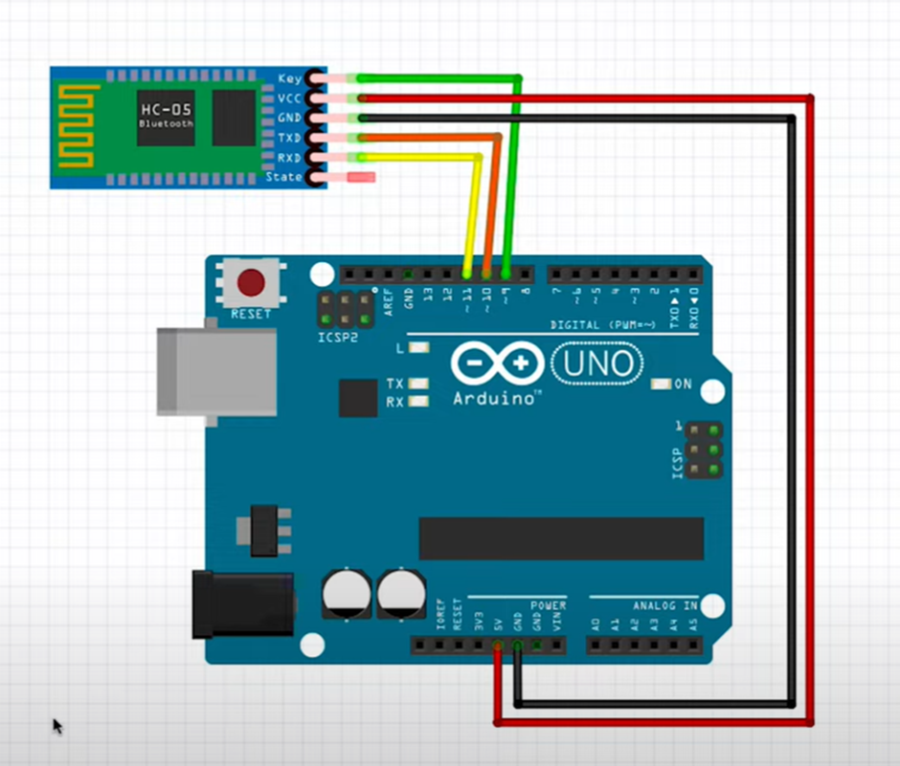
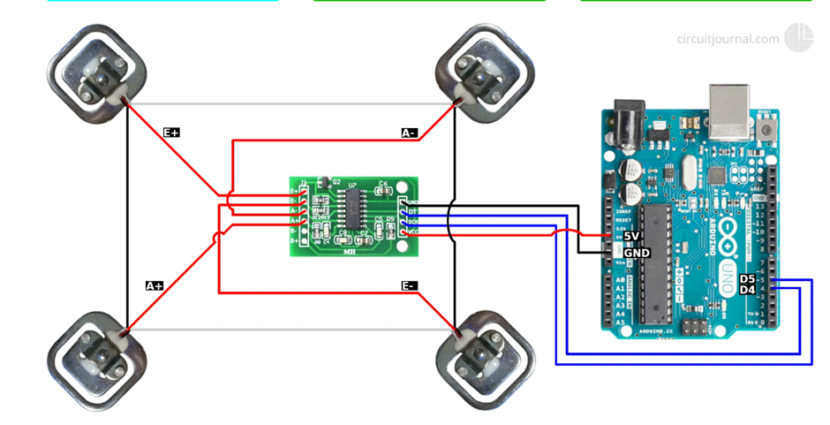
Modules and Implementation Details
IoT Components
This module deals with the hardware that includes the loadcell, the arduino board and the microcontroller that acts as a bridge between the two. The weight of the load is measured by the load cell and is transferred to the arduino through the microcontroller. Taring the weight on the load cell is done to ensure correct readings.

Slide 11
Modules and Implementation Details
App Development
This Module talks about how various pages of an app (each page having a class with attributes and methods) are linked to form a workable system as a whole.
login/register
scan activity
cart items
profile page
orders
previous orders
creation, setup, and of connection firebasebase

Slide 12
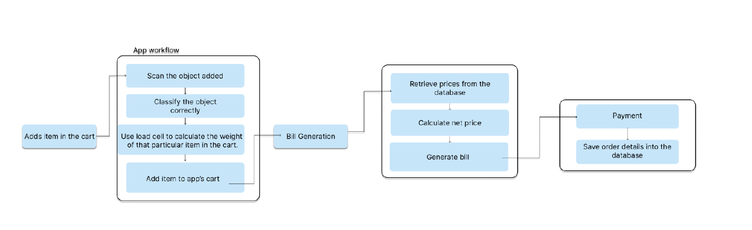
Design Description
WorkFlow diagram

Slide 13
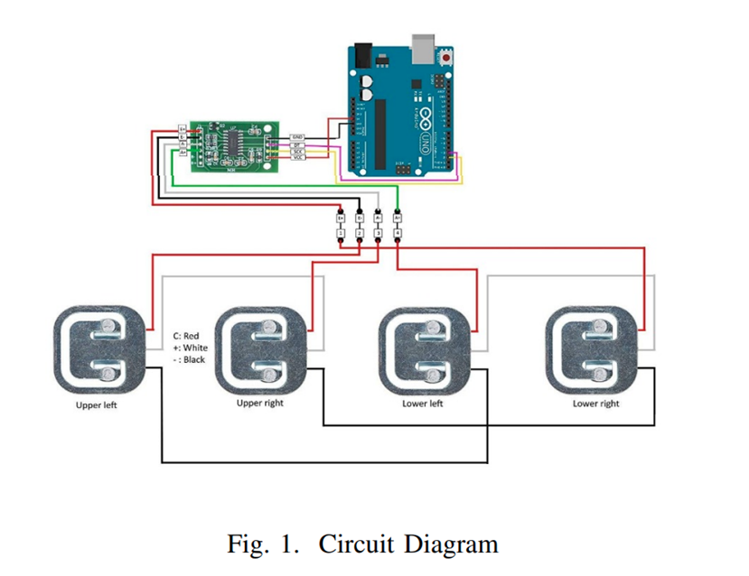
Design Description
Circuit diagram

Slide 14
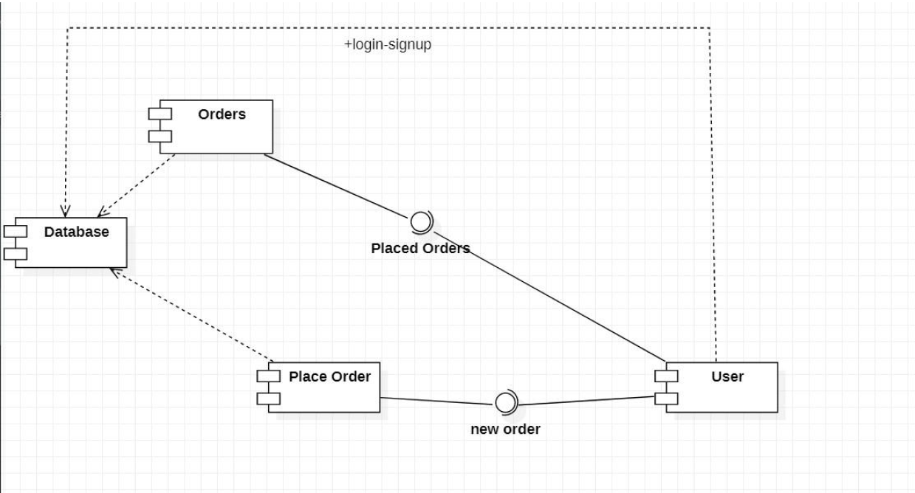
Design Description
Component diagram

Slide 15
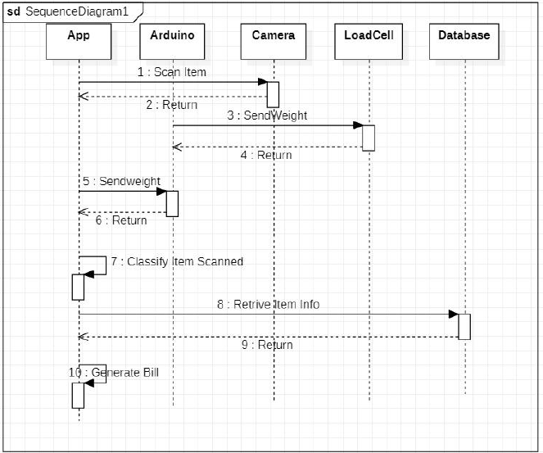
Design Description
Interaction diagram

Slide 16
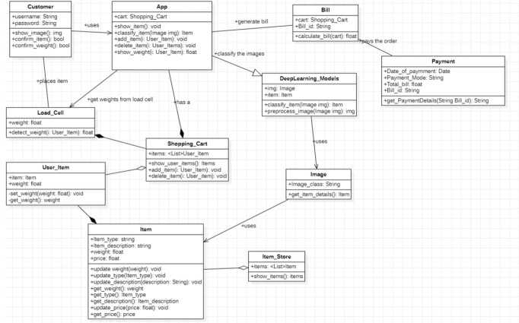
Design Description
Master class diagram

Slide 17
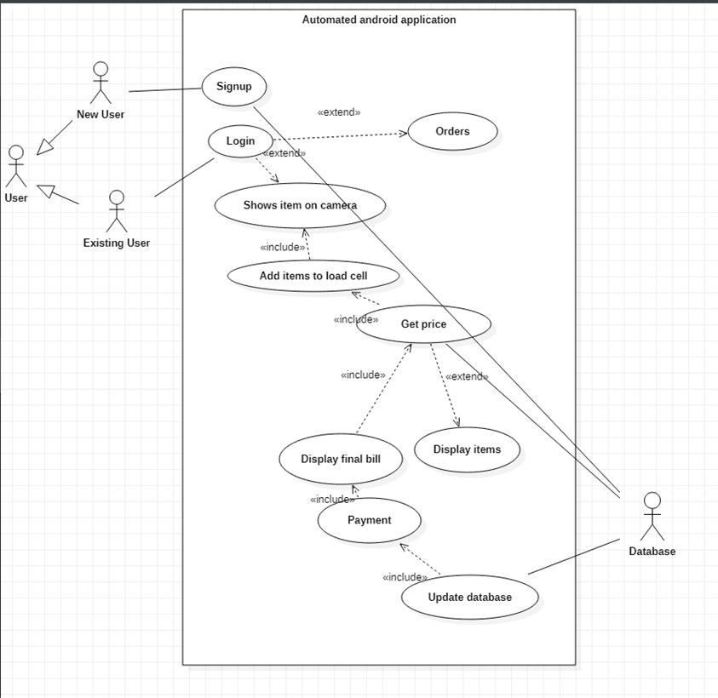
Design Description
Use-Case diagram

Slide 18
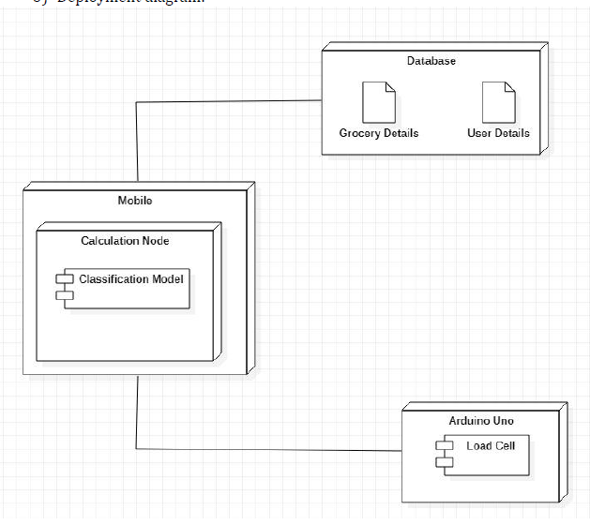
Design Description
Deployment diagram

Slide 19
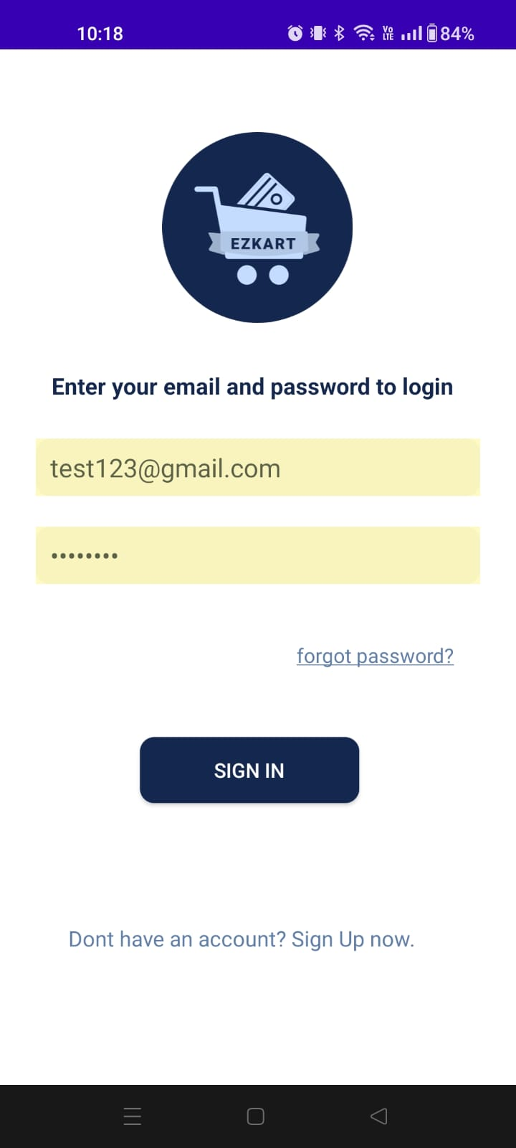
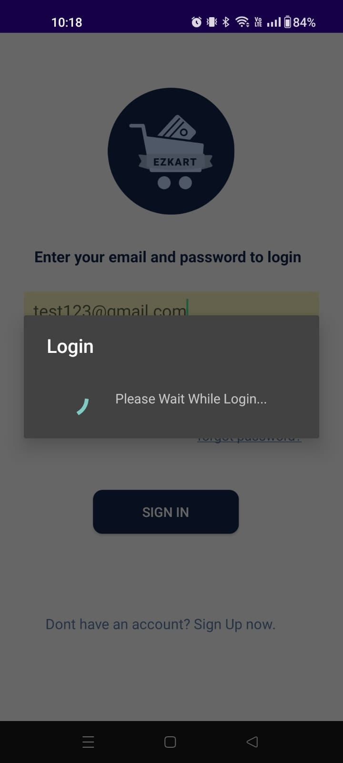
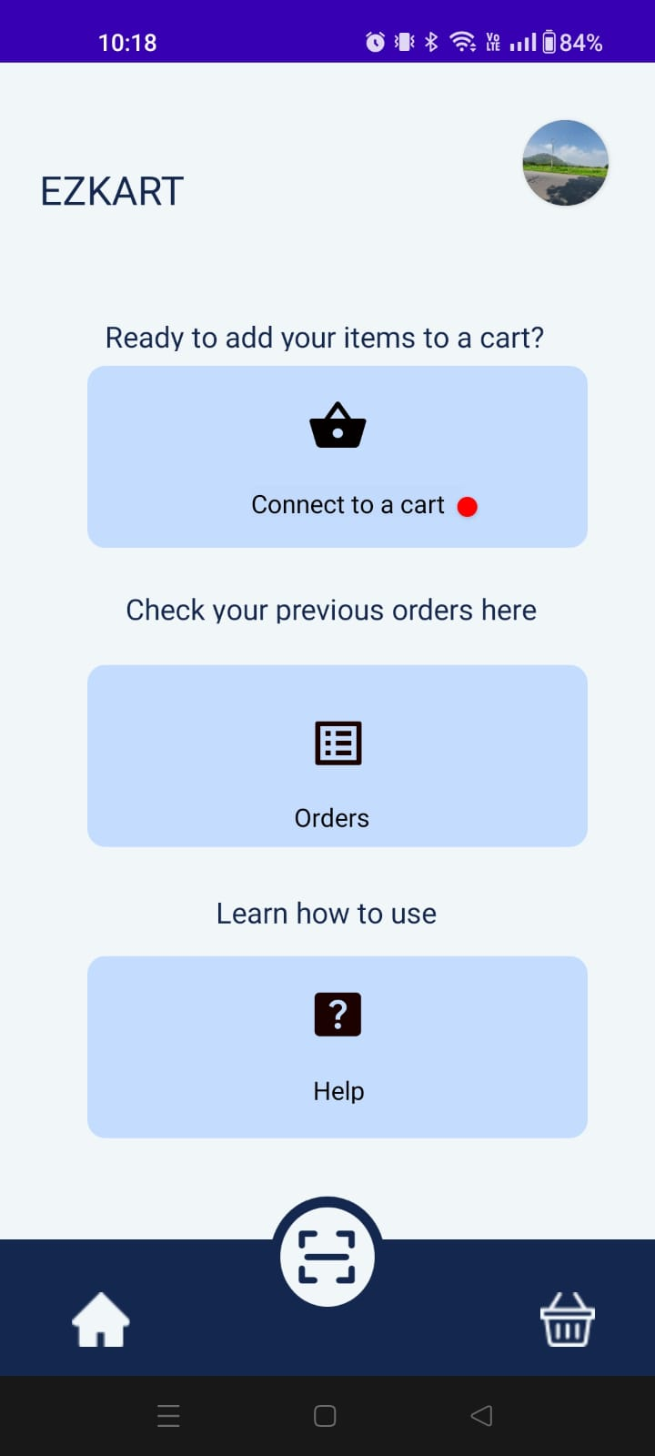
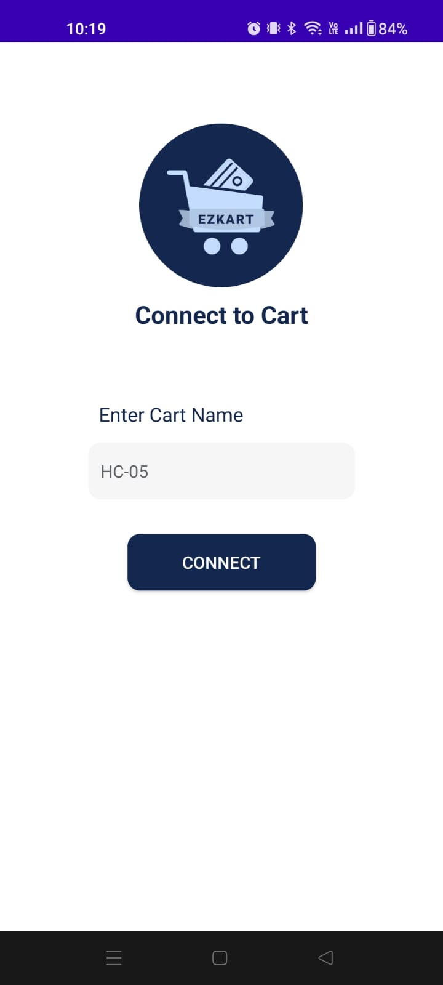
Walkthrough

Slide 20
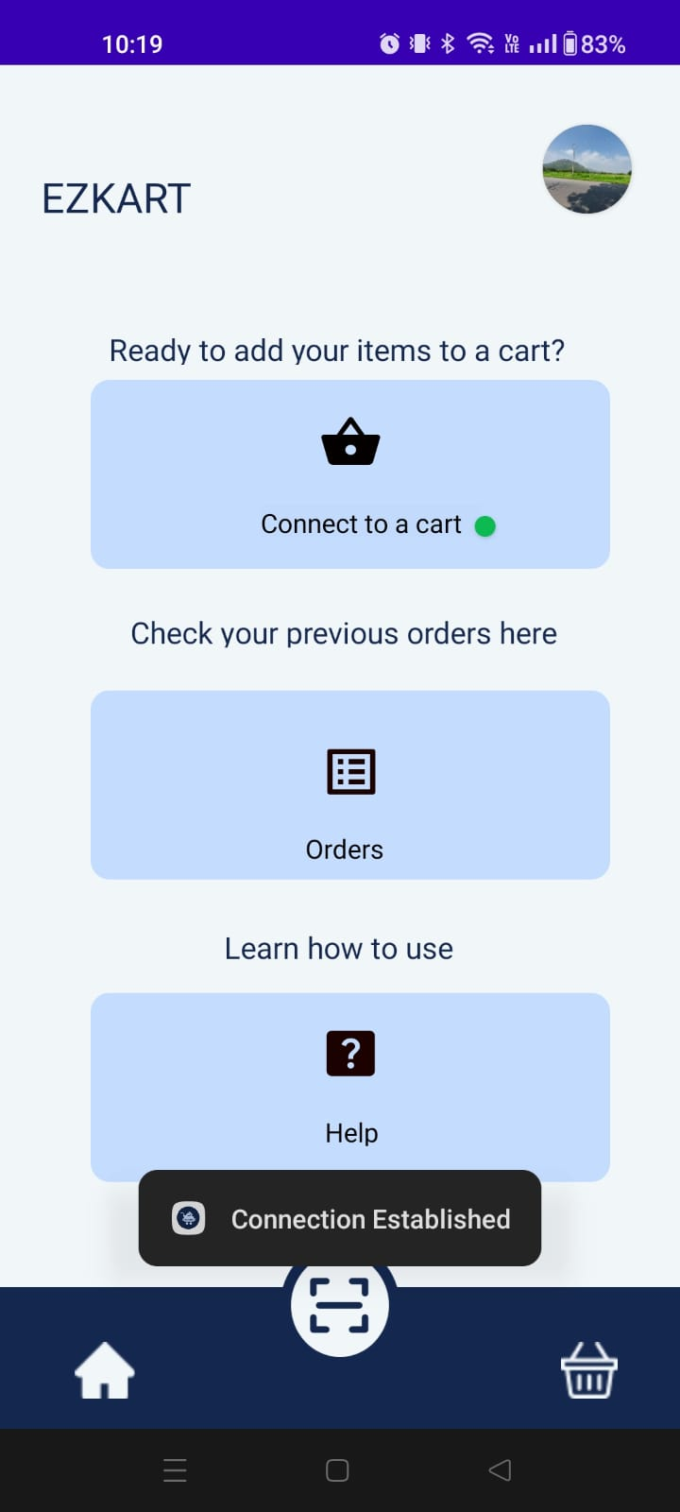
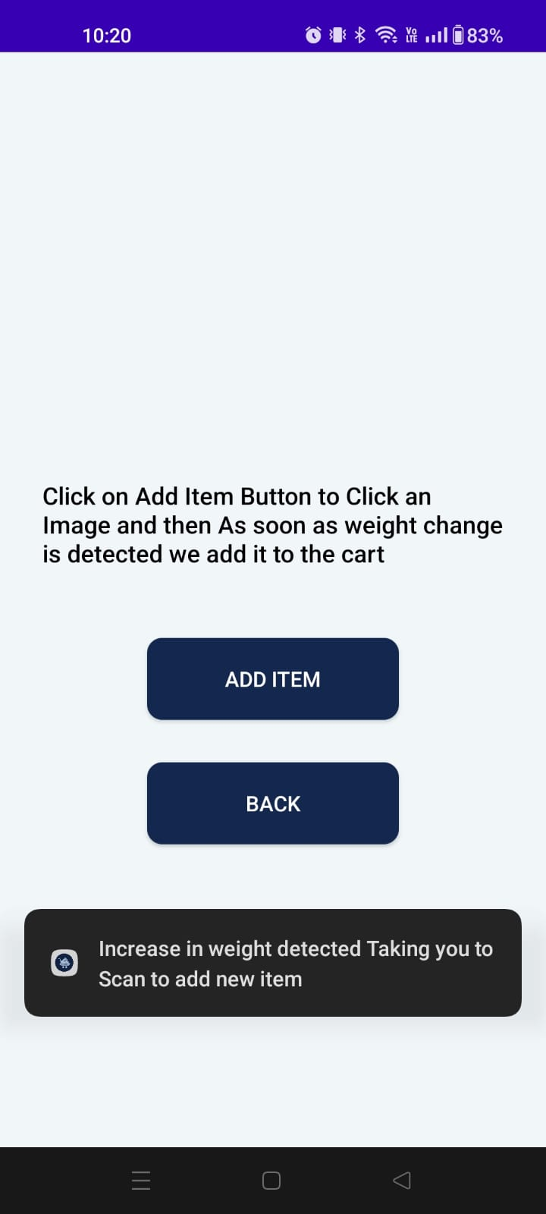
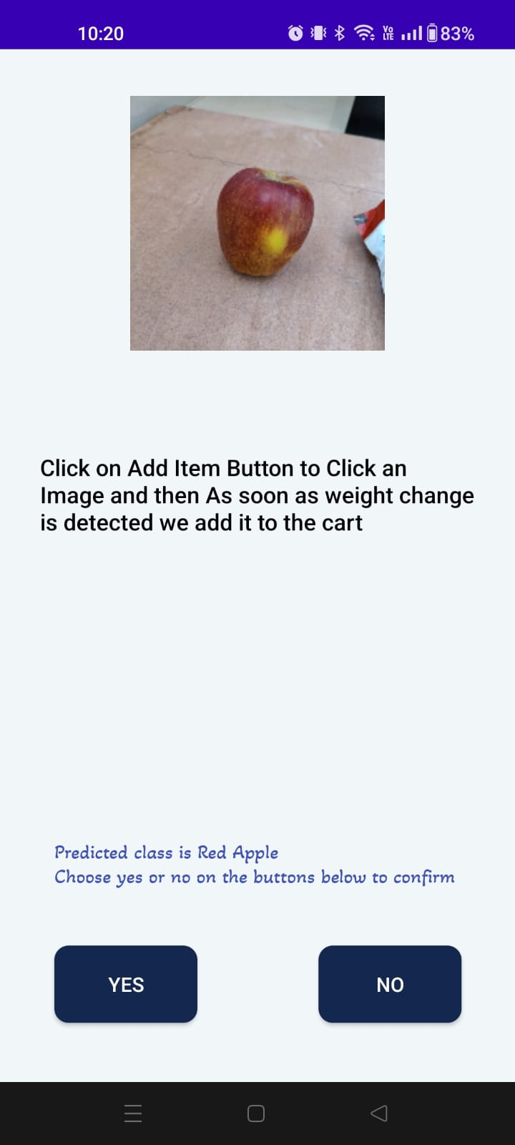
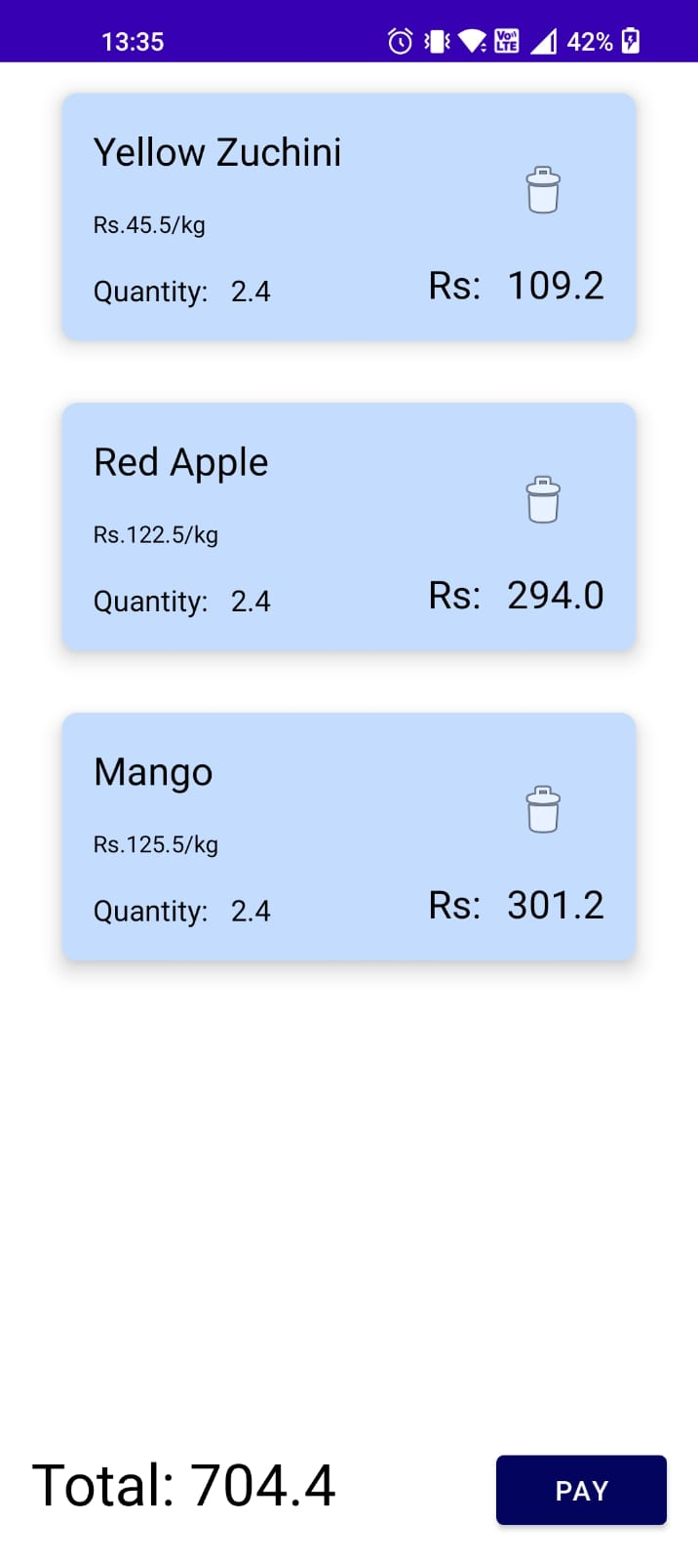
Walkthrough

Slide 21
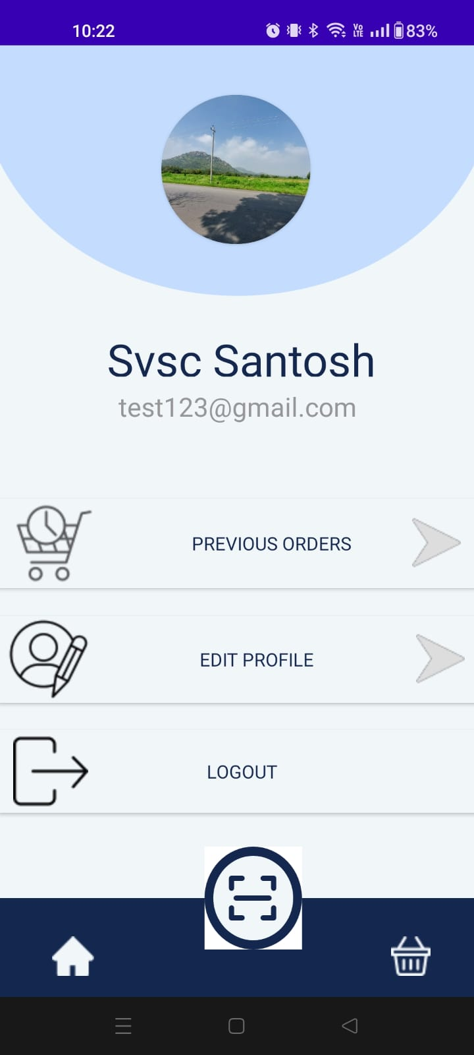
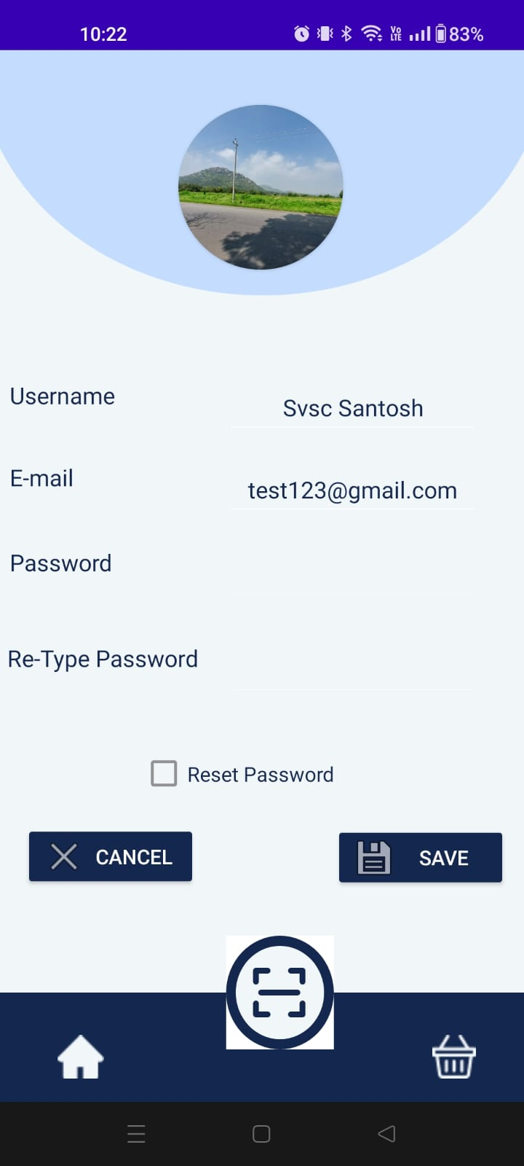
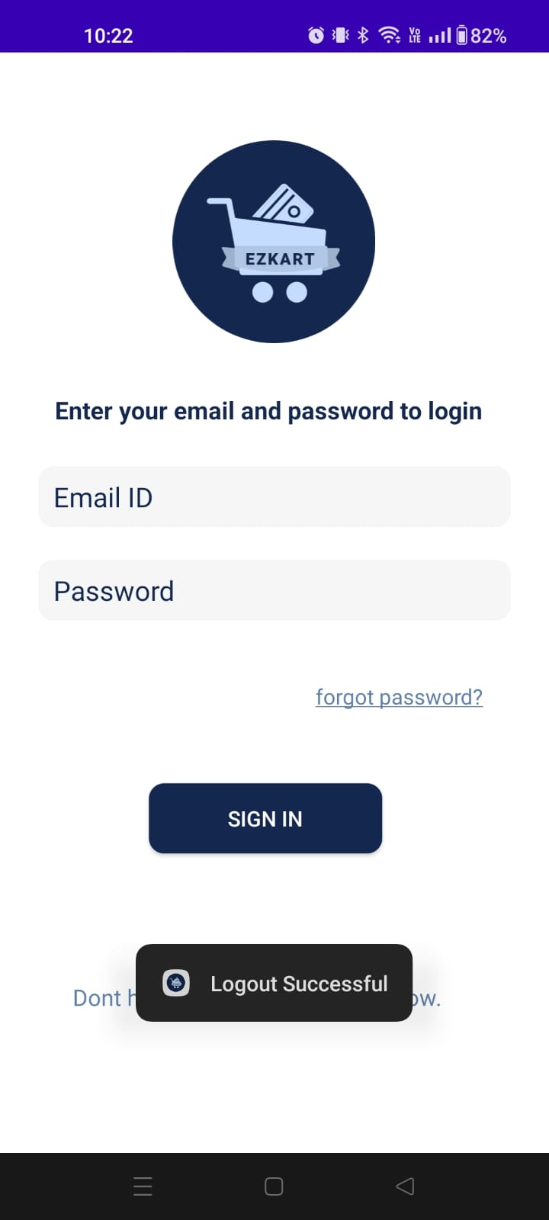
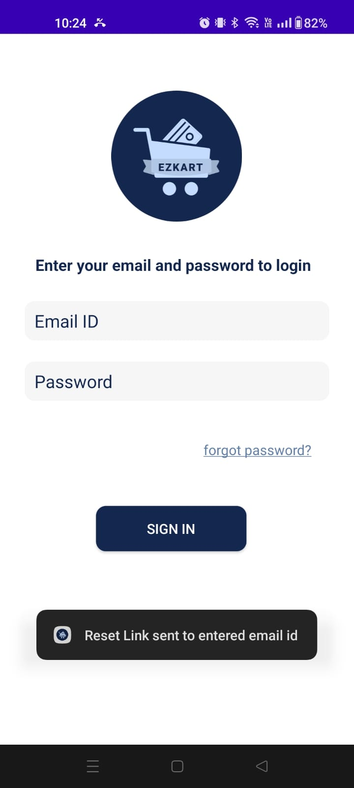
Walkthrough

Slide 22
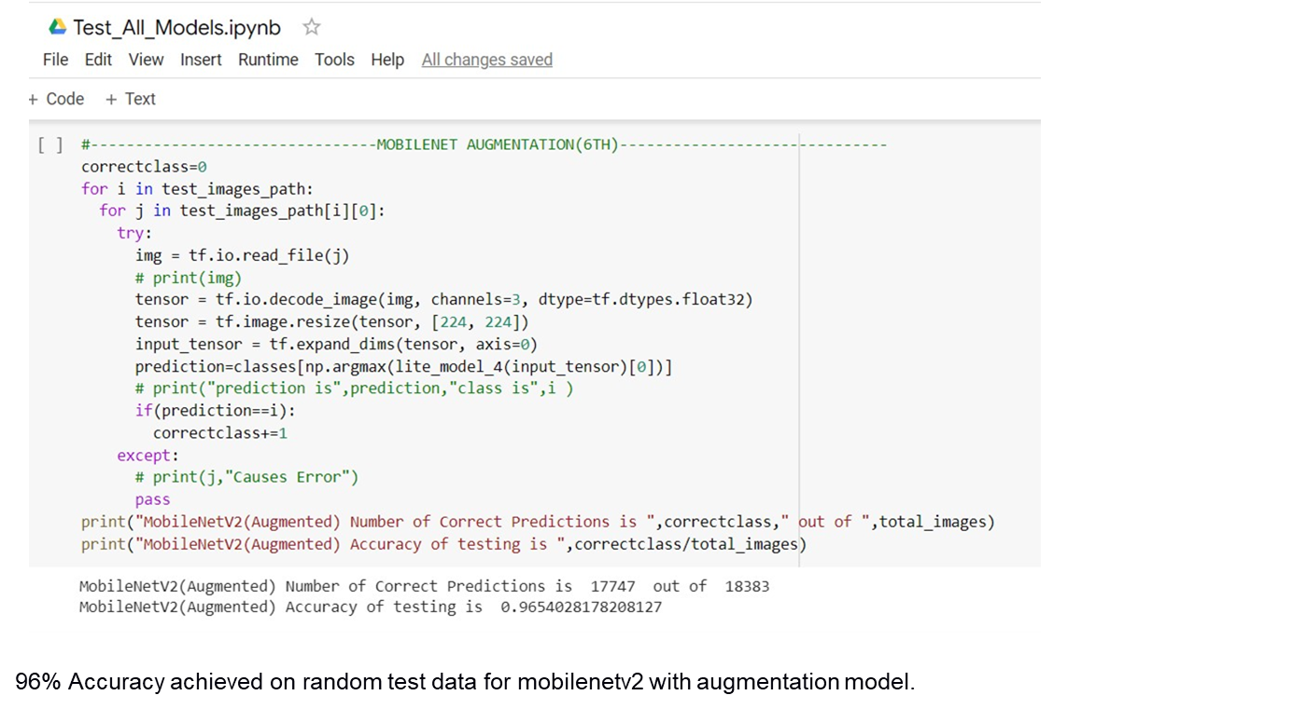
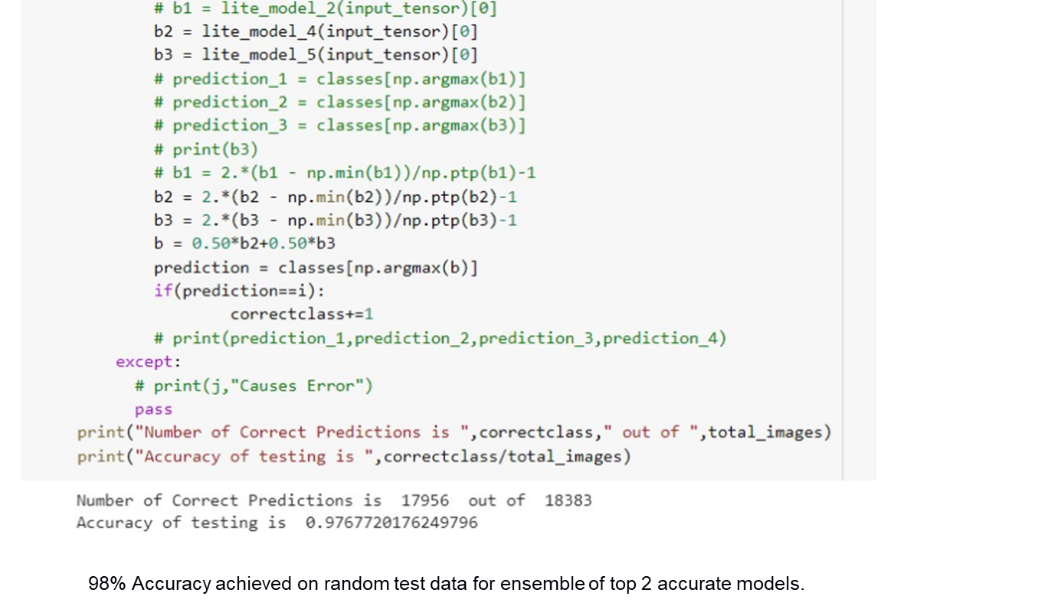
Results and Discussion
Accuracy achieved on training the model to the custom dataset
On trying various models like inceptionv3,nasnet, resnet, mobilenet, efficentnet with and without augmentation we found that the model mobilenet and efficentnet gave an accuracy greater than 95 when the data was augmented. Hence we planned on ensembling both the models to achieve more accuracy.Final testing accuracy that was achieved on ensemble method was 97%.

Slide 23
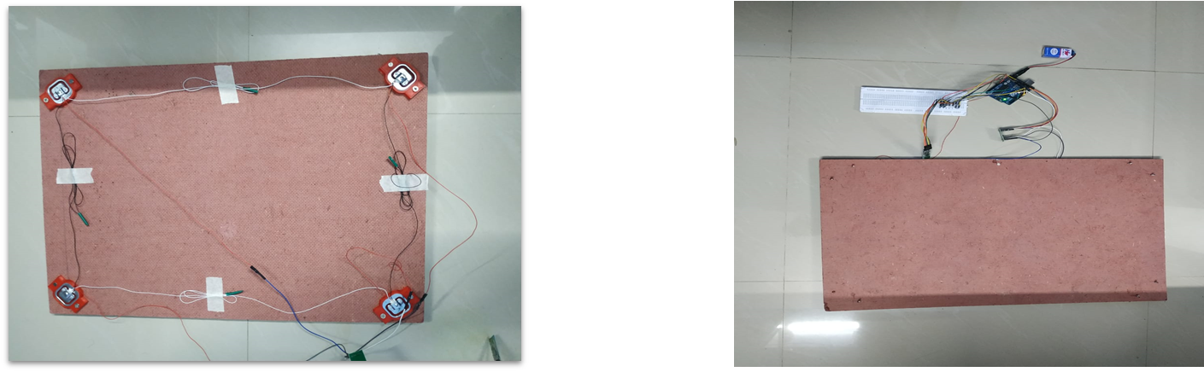
Results and Discussion
Functional android app created
An android app capable of capturing images of products and classifying them with the help of ML models was successfully created. Each item is added to the bill with weight captured from load cell and price looked up from the database
iOT Components connected
The load cell was connected to an arduino board through an amplifier to detect minimal changes in weight. The arduino communicates with the app via a bluetooth module.

Slide 24
Documentation
IEEE Paper link: https://www.overleaf.com/read/cqskgjbgwnwt
Video of the project
Github repository link: https://github.com/svscsantosh/Automated-Shopping-Cart

Slide 25
Conclusion and Future work
Plan to make it work even for items with barcode.
Plan to make it more user friendly by reducing wait time (35s).
Plan to implement real-time classification.
Plan to improve load bearing plate and overall wiring layout.

Slide 26
References
REFERENCES
[1] Jaime Duque Domingo , Roberto Medina Aparicio, and Luis Miguel Rodrigo. “Cross Validation Voting for Improving CNN Classification in Grocery Products.” IEEE Access 10 (2022): 20913–25.
[2] Shubham B Dubey, Gaurav M Kadam, and Omkar Angane. “International Research Journal of Engineering and Technology (IRJET).” Android Application for Grocery Ordering System, 2021.
[3] Marcus Klasson, Cheng Zhang, and Hedvig Kjellstrom. “A Hierarchical Grocery Store Image Dataset with Visual and Semantic Labels.” 2019 IEEE Winter Conference on Applications of Computer Vision (WACV), 2019.
[4] Jose Luis Rojas-Aranda, Jose Ignacio Nunez-Varela, J. C. Cuevas-Tello, and Gabriela Rangel-Ramirez. “Fruit Classification for Retail Stores Using Deep Learning.” Lecture Notes in Computer Science, 2020, 3–13.
[5] Ameema Zainab, and Dabeeruddin Syed. “Deployment of Deep Learning Models on Resource-Deficient Devices for Object Detection.” 2020 IEEE International Conference on Informatics, IoT, and Enabling Technologies (ICIoT), 2020.

Slide 27
Thank You

